Slide 1

Application Software
a.pradeep@newuzbekistanuniversity.uz

Slide 2
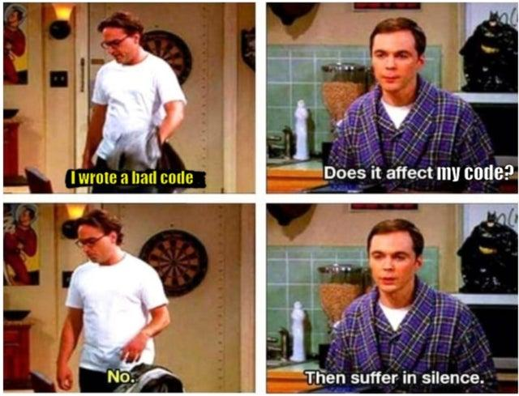
Lesson Overview
Understanding Types of Application Software
Examples and Use Cases of Application Software
Exploring the Software Lifecycle in Software Engineering
Comparing Development Processes: Waterfall and Incremental
Analysis, Design, Implementation, and Testing Phases
Emphasising Quality and Approaches at Each Stage
a.pradeep@newuzbekistanuniversity.uz

Slide 3
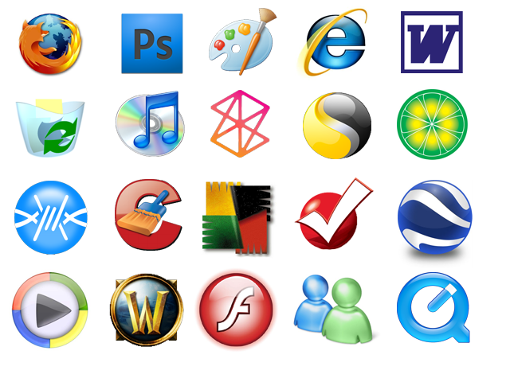
Application Software
Something that was not defined in the von Neumann model is software engineering, which is the design and writing of structured programs.
Today it is not acceptable just to write a program that does a task: the program must follow strict rules and principles.
a.pradeep@newuzbekistanuniversity.uz

Slide 4
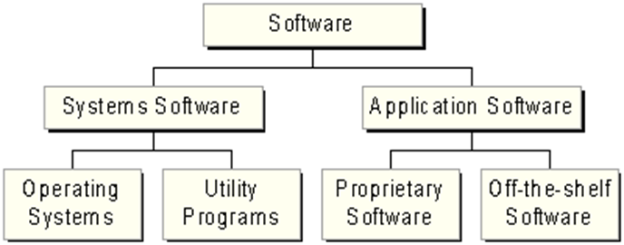
Application Software
Application software consists of programs designed to make users more productive and/or assist with personal tasks
To make business activities more efficient
To assist with graphics and multimedia projects
To support home, personal, and educational tasks
To facilitate communications
a.pradeep@newuzbekistanuniversity.uz

Slide 5
Types of Application Softwares
Name some applications that are used for (2 min)
Business
Graphics and Multimedia
Home/Personal/ Educational
Communication
a.pradeep@newuzbekistanuniversity.uz

Slide 6
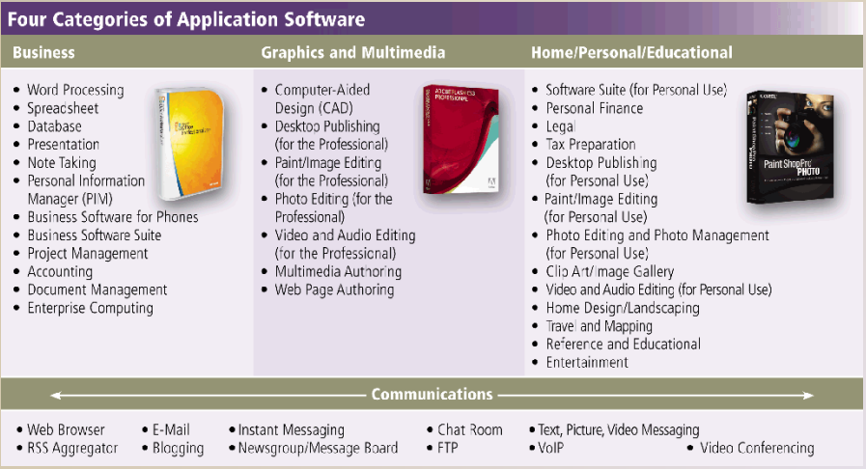
a.pradeep@newuzbekistanuniversity.uz

Slide 7
Variety of Application Softwares
Packaged software / Off the shelf
Custom software
Open source software
Freeware
a.pradeep@newuzbekistanuniversity.uz

Slide 8
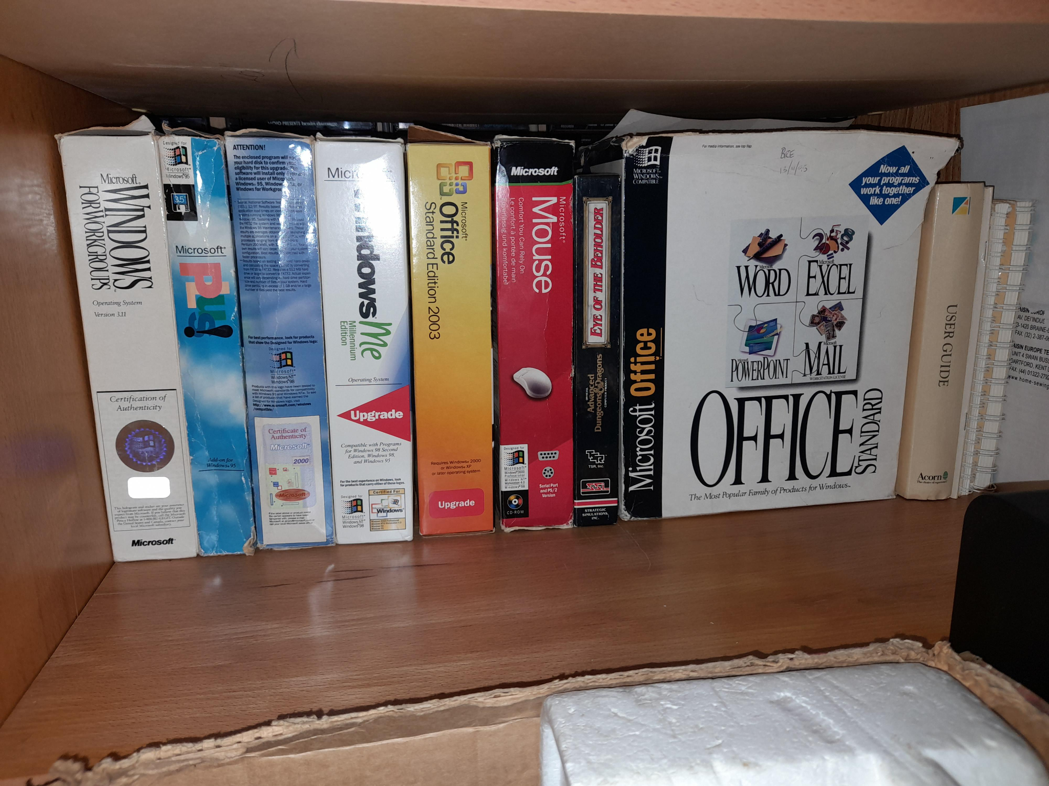
Software Development Lifecycle (SDLC)
A fundamental concept in software engineering is the software lifecycle.
Software is first developed by a group of developers.
These two steps, use and modify, continue until the software becomes obsolete
a.pradeep@newuzbekistanuniversity.uz

Slide 9
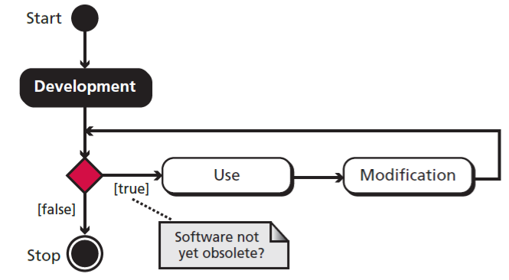
THE SOFTWARE LIFECYCLE
A fundamental concept in software engineering is the software lifecycle.
Software is first developed by a group of developers.
These two steps, use and modify, continue until the software becomes obsolete
a.pradeep@newuzbekistanuniversity.uz

Slide 10
Development process models
The development process in the software lifecycle involves four phases: analysis, design, implementation, and testing.
There are several models for the development process.
We discuss the two most common here: the waterfall model and the incremental model.
a.pradeep@newuzbekistanuniversity.uz

Slide 11
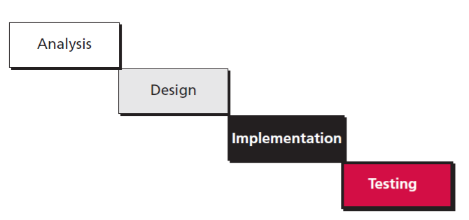
The waterfall model
The development process flows in only one direction.
Phase cannot be started until the previous phase is completed.
a.pradeep@newuzbekistanuniversity.uz

Slide 12
The waterfall model pros and cons
This model is simple and easy to understand and use.
It is easy to manage due to the rigidity of the model
Phases are processed and completed one at a time. Phases do not overlap.
Waterfall model works well for smaller projects where requirements are clearly defined and very well understood.
a.pradeep@newuzbekistanuniversity.uz

Slide 13
The waterfall model pros and cons
Once an application is in the testing stage, it is very difficult to go back and change something that was not well-thought out in the concept stage.
No working software is produced until late during the life cycle.
High amounts of risk and uncertainty.
Not a good model for complex projects.
Poor model for long and ongoing projects.
Not suitable for the projects where requirements are at a moderate to high risk of changing.
a.pradeep@newuzbekistanuniversity.uz
Notes:
Object-oriented refers to a programming language, system or software methodology that is built on the concepts of logical objects. It works through the creation, utilization and manipulation of reusable objects to perform a specific task, process or objective.

Slide 14
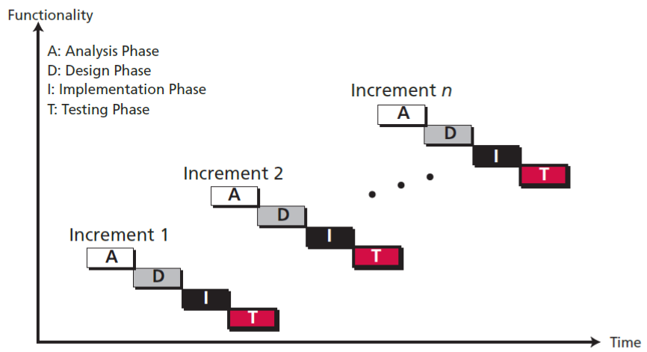
The incremental model
The developers first complete a simplified version of the whole system.
This version represents the entire system but does not include the details.
a.pradeep@newuzbekistanuniversity.uz

Slide 15
Advantages of Incremental Model
Errors are easy to detect.
Easy to test and debug.
Flexible.
Easy to manage risk because it has been managed through iteration.
The client is provided with significant functionality at an early stage.
Disadvantages of Incremental Model
It needs good planning.
The total cost is high.
a.pradeep@newuzbekistanuniversity.uz

Slide 16

ANALYSIS PHASE
The development process starts with the analysis phase.
This phase results in a specification document that shows what the software will do without specifying how it will be done.
a.pradeep@newuzbekistanuniversity.uz

Slide 17
Quick Discussion (5min)
I am a house owner , I have a few apartments. I want to develop a website to get more clients.
As a developer what questions would you like to ask to understand the complete requirements ?
a.pradeep@newuzbekistanuniversity.uz

Slide 18
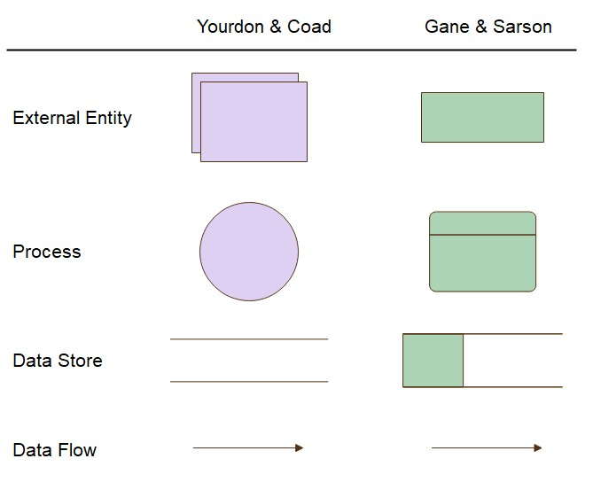
Design / Data flow diagrams
a.pradeep@newuzbekistanuniversity.uz

Slide 19
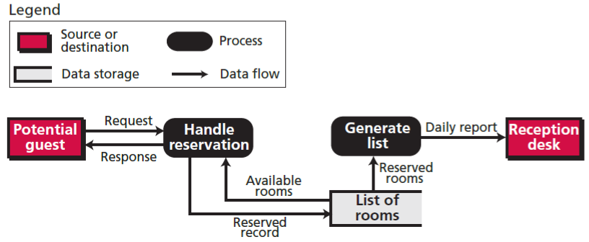
Data flow diagrams
a.pradeep@newuzbekistanuniversity.uz

Slide 20
Implementation Phase
Choice of language:
In a procedure-oriented development-the project team needs to choose a language, for example Fortran, Cobol, Basic, Pascal and C
In object-oriented cases, both C++ and Java are common.
Software quality - The quality of software created at the implementation phase is a very important issue.
A software system of high quality is:
satisfies the user’s requirements
meets the operating standards of the organization
runs efficiently on the hardware for which it was developed.
a.pradeep@newuzbekistanuniversity.uz

Slide 21
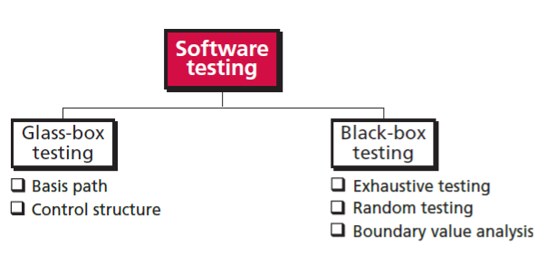
Testing Phase
a.pradeep@newuzbekistanuniversity.uz

Slide 22
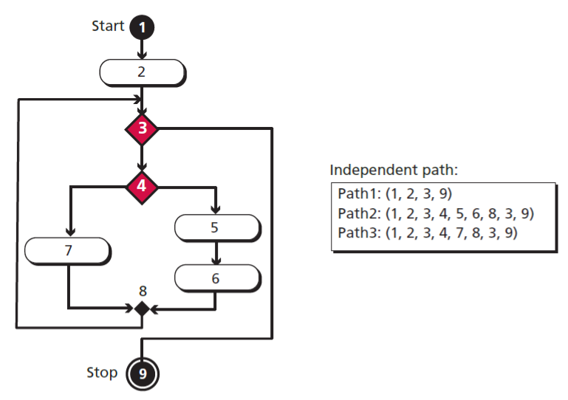
Basis path testing
Basis path testing is a method in which each statement in the software is executed at least once.
a.pradeep@newuzbekistanuniversity.uz

Slide 23
Control structure testing
Condition testing - is designed to check whether all conditions are set correctly.
Data flow testing- Data flow testing is based on the flow of data through the module.
Loop testing- Loop testing uses test cases to check the validity of loops. All types of loops (while, do, and for) are carefully tested.
a.pradeep@newuzbekistanuniversity.uz

Slide 24
Black-box testing
Exhaustive testing - method is to test the software for all possible values in the input domain.
Random testing- a subset of values in the input domain is selected for testing. It is very important that the subset be chosen in such a way that the values are distributed over the domain input.
Boundary-value testing-if a module defines that one of its inputs must be greater than or equal to 100, it is very important that module be tested for the boundary value 100.
a.pradeep@newuzbekistanuniversity.uz

Slide 25
Documentation
Documentation is an ongoing process
User documentation-show how to run the software system properly, the users need documentation, that shows how to use the software step by step.
System documentation-defines the software itself. It should be written so that the software can be maintained and modified by people other than the original developers.
Technical documentation-describe the installation and the servicing of the software system.
a.pradeep@newuzbekistanuniversity.uz

Slide 26
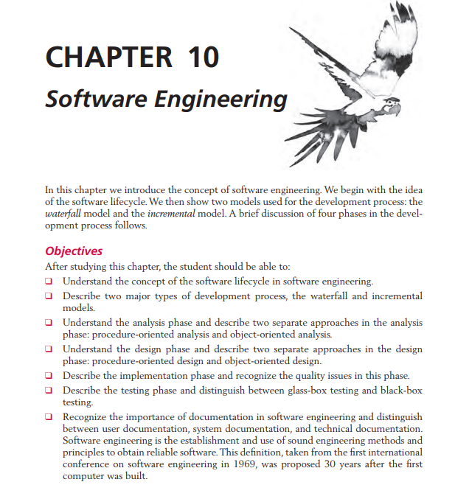
Read Pages 273 - 288
https://drive.google.com/file/d/1qx--17mQzYWXPvlKZyYd-ByV7AT7Y9Kk/view?usp=sharing
a.pradeep@newuzbekistanuniversity.uz

